Slide 1
What is Artificial intelligence, Machine Learning and Deep Learning?
Marcus Rüb
Hahn-Schickard Villingen-Schwenningen
Marcus.rueb@hahn-schickard.de
Notes:
Ob intelligenter Kühlschrank oder Sprachassistent, bereits heute sind in unserem Alltag viele Dinge mit künstlicher Intelligenz ausgestattet. Im Zeitalter des Internet of Things (IoT) und der Industrie 4.0 werden intelligente Systeme immer wichtiger.
Zur Ausführung von vielen neuronalen Netzen wird allerdings nicht immer die Rechenleistung von großen und teuren Rechner benötigt. Stattdessen kann hier auch die Rechenleistung eines eingebetteten Systems, wie die eines Mikrocontrollers, ausreichen.
Allerdings ist die Unterstützung von Plattformen zur Ausführung von neuronalen Netzen, nicht ohne weiteres gegeben ist.
Das Modell muss zuerst manuell konvertiert, eingebunden und ausgeführt werden

Slide 2

This Session:
Introduction
What is Machine Learning?
Examples
How Machine Learning works?
Machine Learning concepts

Slide 3
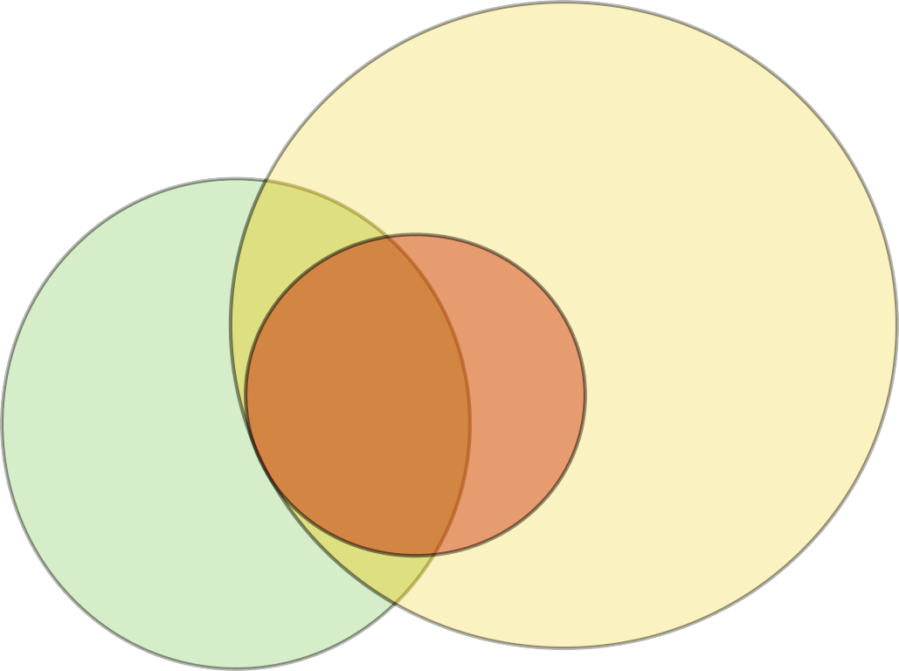
The Connection Between Fields
Machine Learning
Deep Learning
AI

Slide 4

The Connection Between Fields
Artiﬁcial Intelligence (AI):
orig. subﬁeld of computer science, solving tasks humans are good at (natural language, speech, image recognition, ...)
Artiﬁcial General Intelligence (AGI):
multi-purpose AI mimicking human intelligence across tasks
Narrow AI:
solving "a" task (playing a game, driving a car, ...)
Machine Learning
Deep Learning
AI

Slide 5
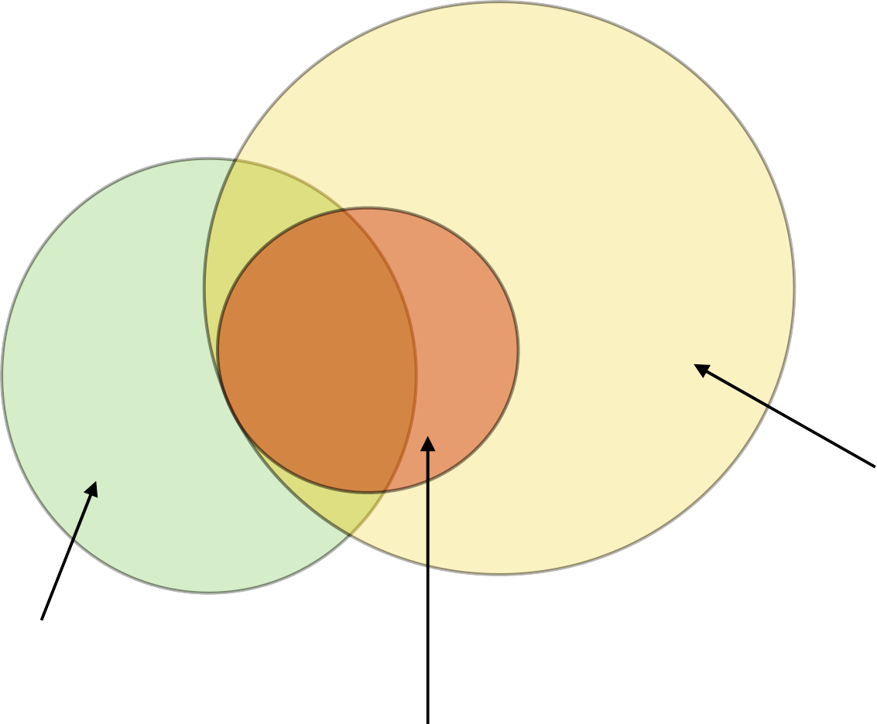
Machine Learning
Deep Learning
AI
E.g.,
generalized linear models, tree-based methods, "shallow" networks, SVM, nearest neighbors, ...
E.g., symbolic expression, logic rules / "handcrafted" nested if-else programming statements ...
Main focus of the course

Slide 6
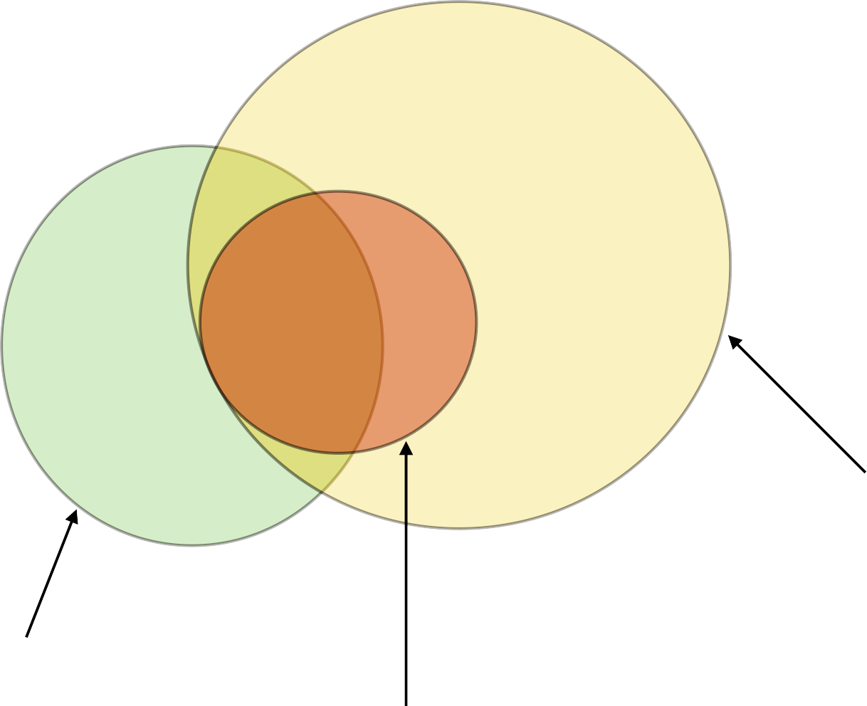
Machine Learning
Deep Learning
AI
= algorithms that learn models/representations/ rules automatically
from data/examples
= a non-biological system that is intelligent
through rules
= algorithms that parameterize multi-layers neural networks that then learn representations of data with multiple layers of abstraction

Slide 7
What’s Machine Learning?
The science (and art) of programming computers so that they can learn from data [Aurélien Géron, 2017]
“The field of study that gives computers the ability to learn without being explicitly programmed” [Artur Samuel, 1959]
“A computer program is said to learn from experience E with respect to some task T and some performance measure P, if its performance on T, as measured by P, improves with experience E” [Tom Mitchell, 1997]

Slide 8

How is Machine Learning different from programming
Perform task
Perform task
Data
Program
Results Data
Model
Results
Learning
Data
Requirements
Program
ML
Model
Results
Only for some tasks

Slide 9
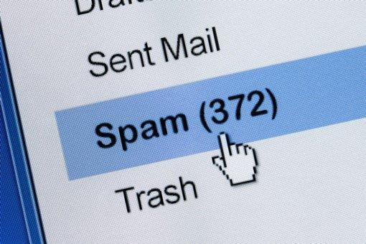

Which tasks can Machine Learning perform?
- Let’s see some examples
Spam Filter
Recommendation Engine

Slide 10

Which tasks can Machine Learning perform?
Real Estate
Predict at which price
a property will be sold

Slide 11

Which tasks can Machine Learning perform?
Advertising
Predict which ads you are
more likely to click on

Slide 12
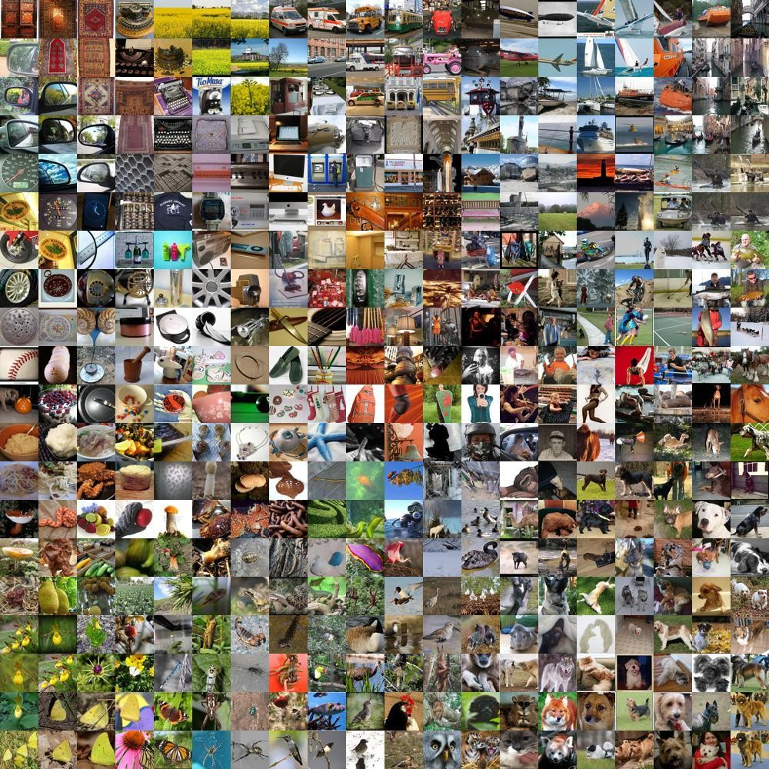
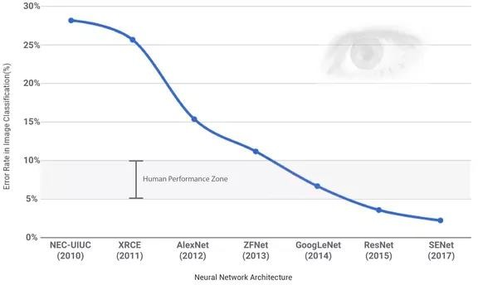
Which tasks can Machine Learning perform?
Image Classification

Slide 13
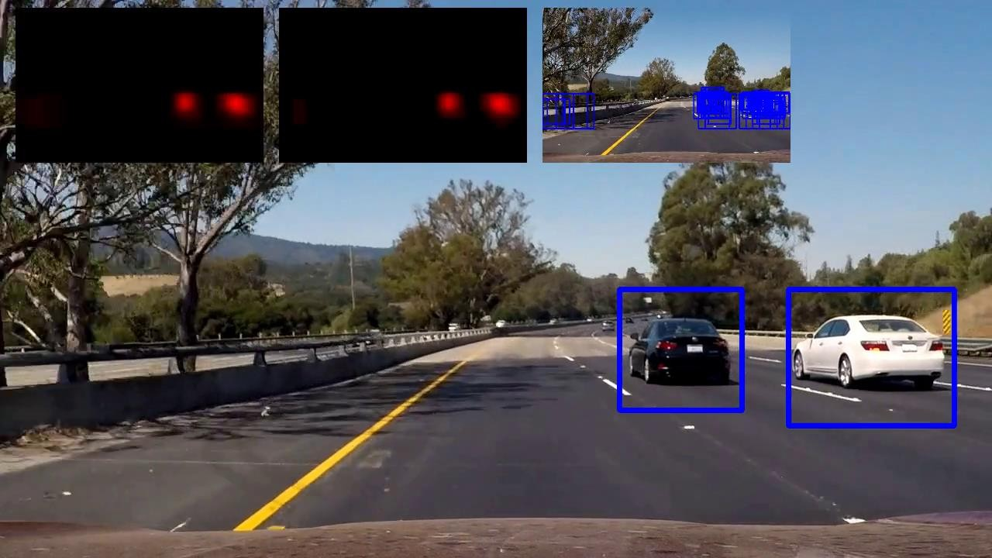
Which tasks can Machine Learning perform?
Self-driving cars
Marcus.Rueb@Hahn-Schickard.de - Tel.: 07721/943-180
13

Slide 14

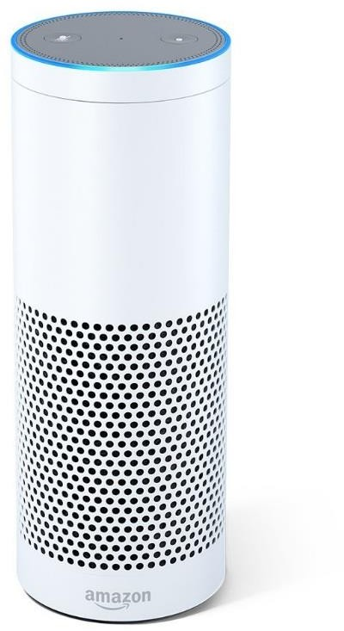

Which tasks can Machine Learning perform?
Speech Recognition
& Synthesis

Slide 15
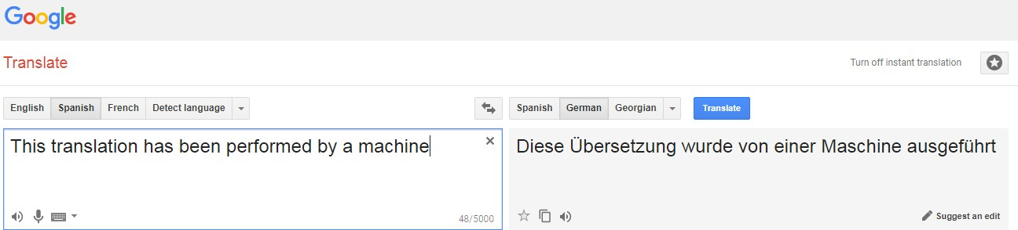
Which tasks can Machine Learning perform?
Language Translation
Marcus.Rueb@Hahn-Schickard.de - Tel.: 07721/943-180
15

Slide 16

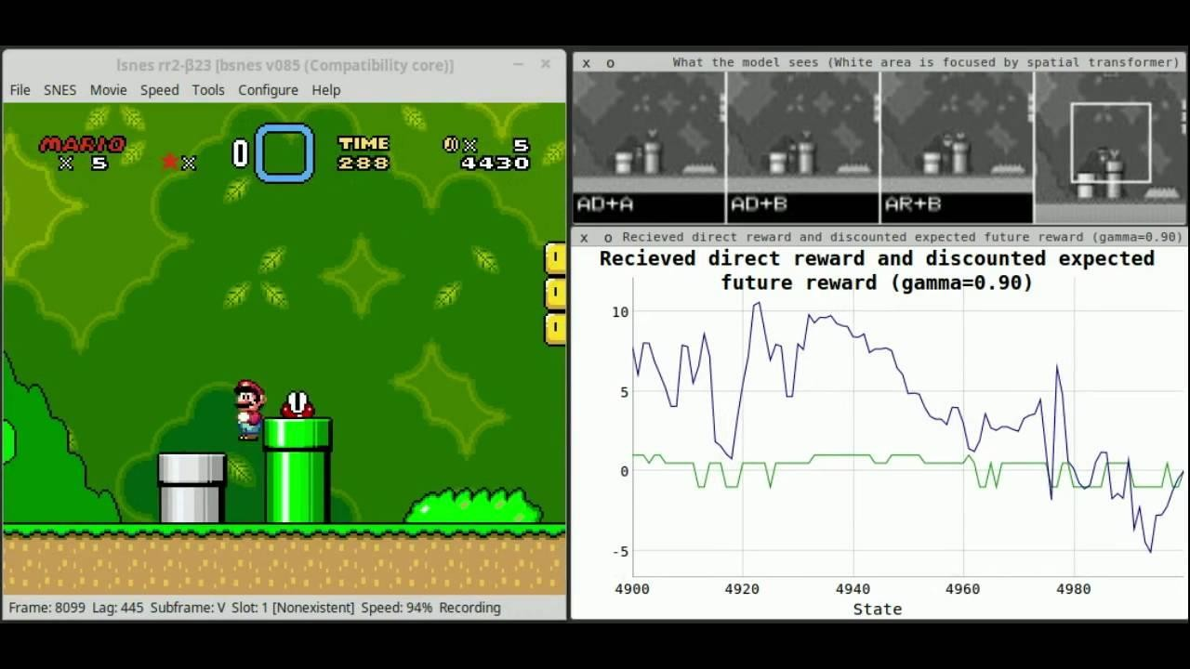
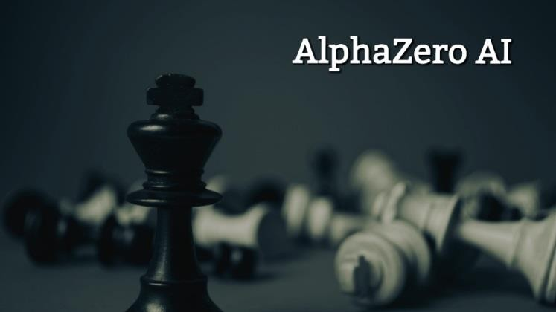
Which tasks can Machine Learning perform?
Playing Games
Marcus.Rueb@Hahn-Schickard.de - Tel.: 07721/943-180
16

Slide 17
Considerations on using Machine Learning
Perform task
There must be a pattern in the input – output relationship (lottery winning numbers cannot be predicted with ML)
Data
Model
Results
There must be enough data to discover this pattern
Learning
Data
ML
Model
Results
It’s difficult to formulate a mathematical expression (otherwise we will just use this formula instead)

Slide 18
How Machine Learning Learns?
Perform task
Different Machine Learning techniques for different kinds of tasks
Data
Model
Results
Learning is finding which model’s parameters represent best the input – output mapping
Learning
Data
ML
Model
Results

Slide 19
How Machine Learning Learns?
Linear Regression example:
Model: f(x) = mx + b
Model’s parameters: m, b
Parameter values: m=1, b=0
Perform task
Data
Model
Results
Learning
Learning is finding which values of ‘m’ and ‘b’ fit the data best (e.g. minimizes the prediction error)
Data
ML
Model
Results

Slide 20
Type of learning
Labeled data Direct feedback
Predict outcome/future
Supervised Learning
Depending on the level of supervision …
Supervised
Unsupervised
Semi-supervised
Reinforcement Learning
No labels/targets No feedback
Find hidden structure in data
Unsupervised Learning
Decision process Reward system
Learn series of actions
Reinforcement Learning

Slide 21
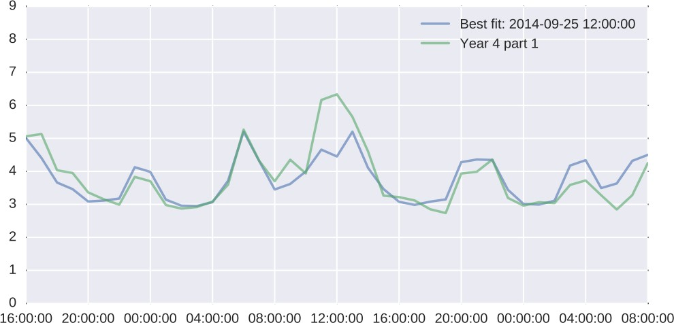
Types of Learning
Supervised
Supervision: we can tell for every case what the correct answer was
Example: predict the thermal power consumption
Focus
Predict the future

Slide 22
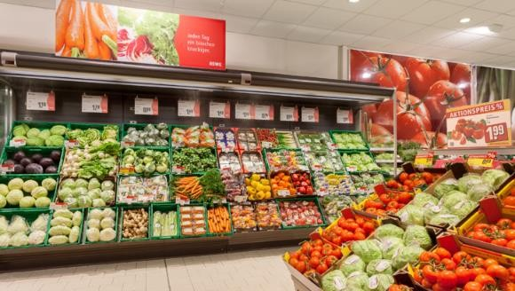
Types of Learning
Unsupervised
Supervision: there is no right answer, we are looking for insights
Example: market basket analysis for supermarkets
Focus
Understand the past

Slide 23
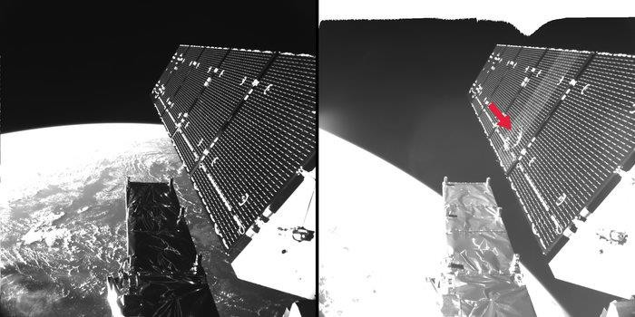
Types of Learning
Semi-supervised
Supervision: we can tell the correct output for a limited number of cases
Example: characterize what a particle impact looks like in TM
Focus
Understand the past
Sentinel-1A: particle impact
on August 23th 2016

Slide 24
Types of Learning
Reinforcement Learning
Supervision: we only know the final outcome, but not intermediate steps
Example: playing Go
Focus
Find which is the next action most likely to lead to the desired outcome

Slide 25
Types of Learning
The type of learning with most industrial applications is
Supervised Learning
(Predictive Analytics)
Depending of what kind of data is predicted we can talk about:
Regression
Classification

Slide 26

Regression
Predict real numbers

Slide 27
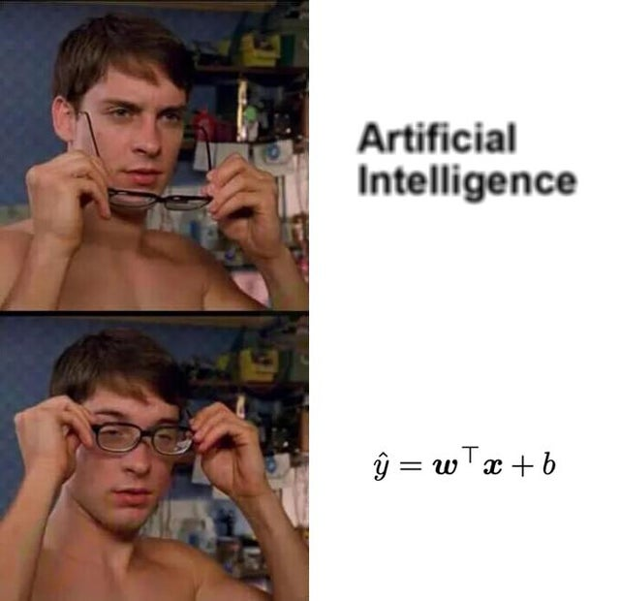















Regression
target (dependent variable)
y
x
feature

Slide 28

Classification
Predict which option out of a limited set of possibilities
Spam Filter
What’s in the picture

Slide 29
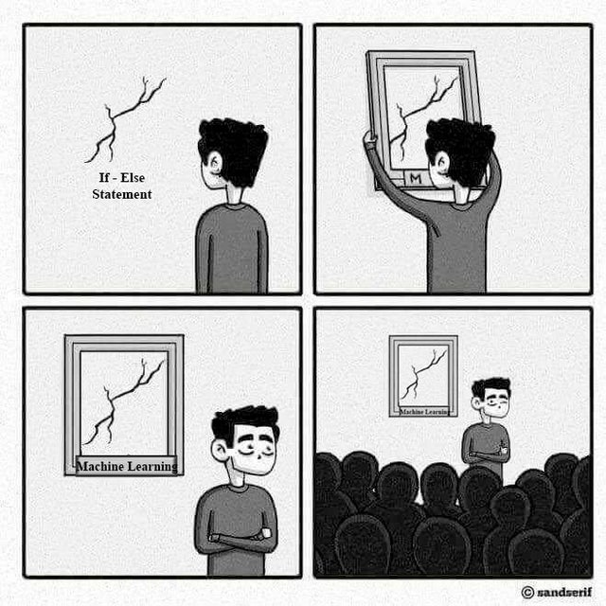






























Classification
Binary classiﬁcation example with
two features ("independent" variables, predictors)
linear decision boundary
x₂
x₁

Slide 30
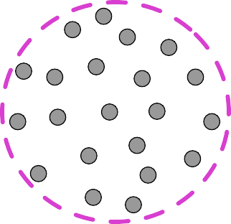
Unsupervised Learning: Clustering
Assigning group memberships to unlabelled examples (instances, data points)
x₂
x₁

Slide 31
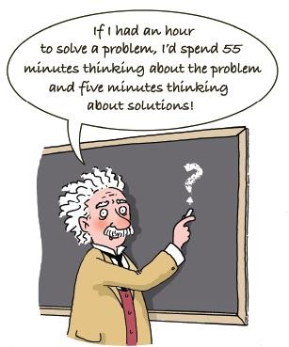
Machine Learning Workflow
Problem Understanding

Slide 32
Machine Learning Workflow
How will we measure how good the model is performing?
Do we know already at what point it would be enough?
Problem Understanding
Evaluation Criteria

Slide 33
Machine Learning Workflow
How the current approach is performing against the evaluation
criteria? Define a simple baseline if there is none (e.g. mean value)
This will allow us to quantify how much Machine Learning helps and if it is worthwhile compared to simpler solutions
Problem Understanding
Evaluation Criteria
Baseline

Slide 34
Machine Learning Workflow
“Enough” data in the sense that it’s representative of the
behaviour the model needs to learn
Features: data transformations that encode your knowledge
Problem Understanding
Evaluation Criteria
Prepare Data
Baseline

Slide 35
Machine Learning Workflow
Use data / features to tune the parameters that optimize the
evaluation criteria (e.g. minimise error)
Problem Understanding
Evaluation Criteria
Prepare Data
Train model
Baseline

Slide 36
Machine Learning Workflow
Understand what the model is doing: where is it right / wrong
More complex model
Problem Understanding
Evaluation Criteria
Prepare Data
Train model
Error Analysis
Simpler model
Baseline
More data / features
Provides better problem understanding

Slide 37
Machine Learning Workflow
When we are happy with the error, we can use the trained
model: new data → features computation → model → results
Production Trained Model
Ready to use More complex model
We now have a better baseline
Problem Understanding
Prepare Data
Train model
Error Analysis
Evaluation Criteria
Simpler model
Baseline
More data / features
Provides better problem understanding
Better baseline

Slide 38
Machine Learning Workflow
Production Trained Model
Ready to use More complex model
Evaluation Criteria
Problem Understanding
Prepare Data
Train model
Error Analysis
Simpler model
Baseline
More data / features
Better problem understanding
Better baseline

Slide 39
Questions:
What is Artificial intelligence, Machine learning and deep learning.
Where do we use AI already?
Explain: Supervised, Unsupervised, Semi-supervised, Reinforcement Learning
Explain: Regression, Classification

Slide 40
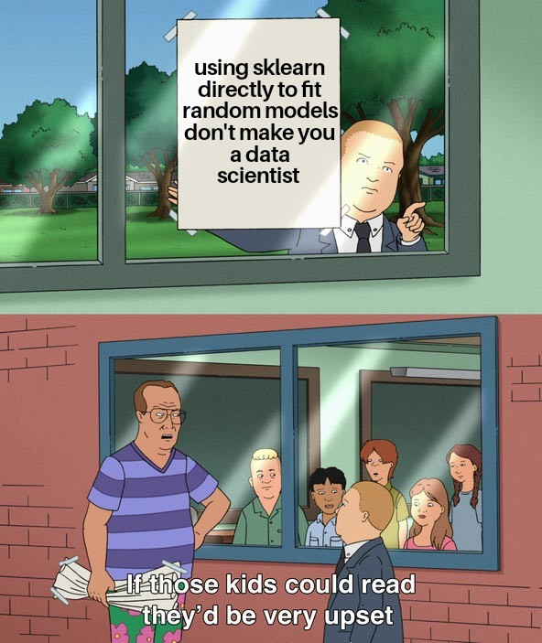
Outlook

